Slide 1
Lecture 11
DTMC – Some More Properties and Examples

Slide 2
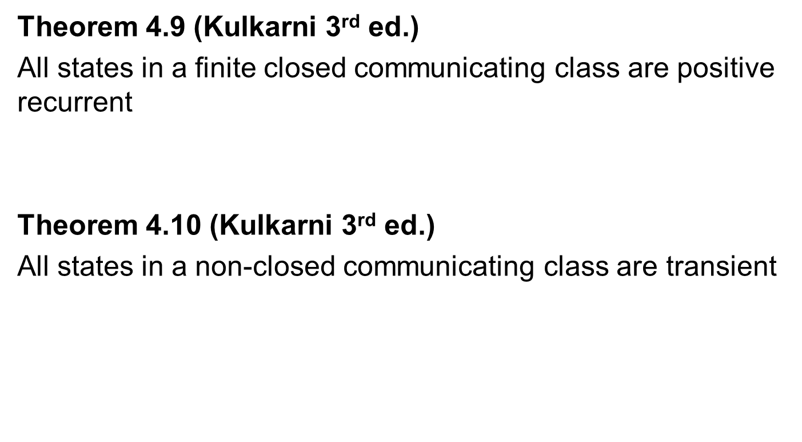
Recurrence vs Transience
Theorem 4.9 (Kulkarni 3rd ed.)
All states in a finite closed communicating class are positive recurrent
Theorem 4.10 (Kulkarni 3rd ed.)
All states in a non-closed communicating class are transient

Slide 3
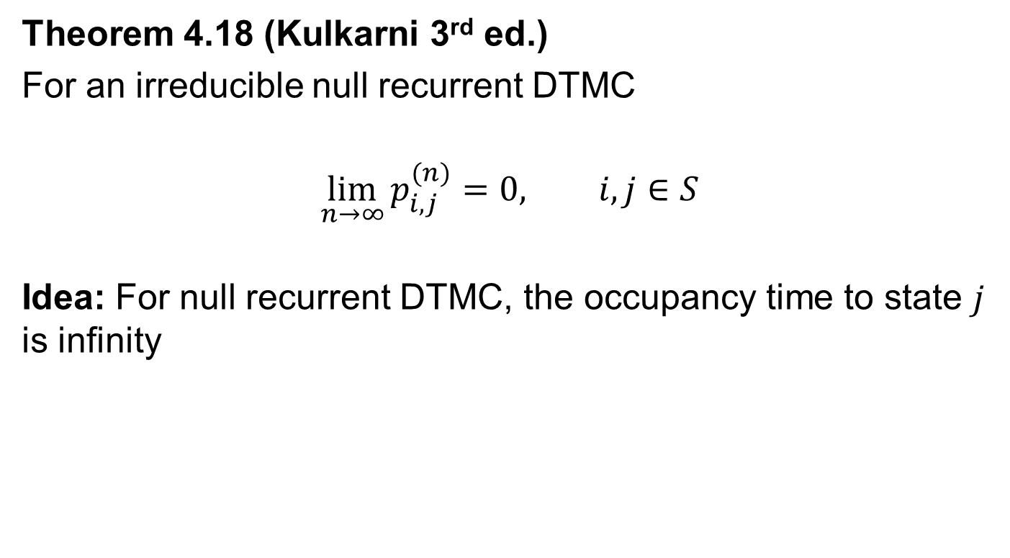
Null Recurrent DTMC
Theorem 4.18 (Kulkarni 3rd ed.)
For an irreducible null recurrent DTMC
$$\lim_{n→∞}{p_{i,j}^{(n)}=0, i,j∈S}$$
Idea: For null recurrent DTMC, the occupancy time to state $j$ is infinity

Slide 4
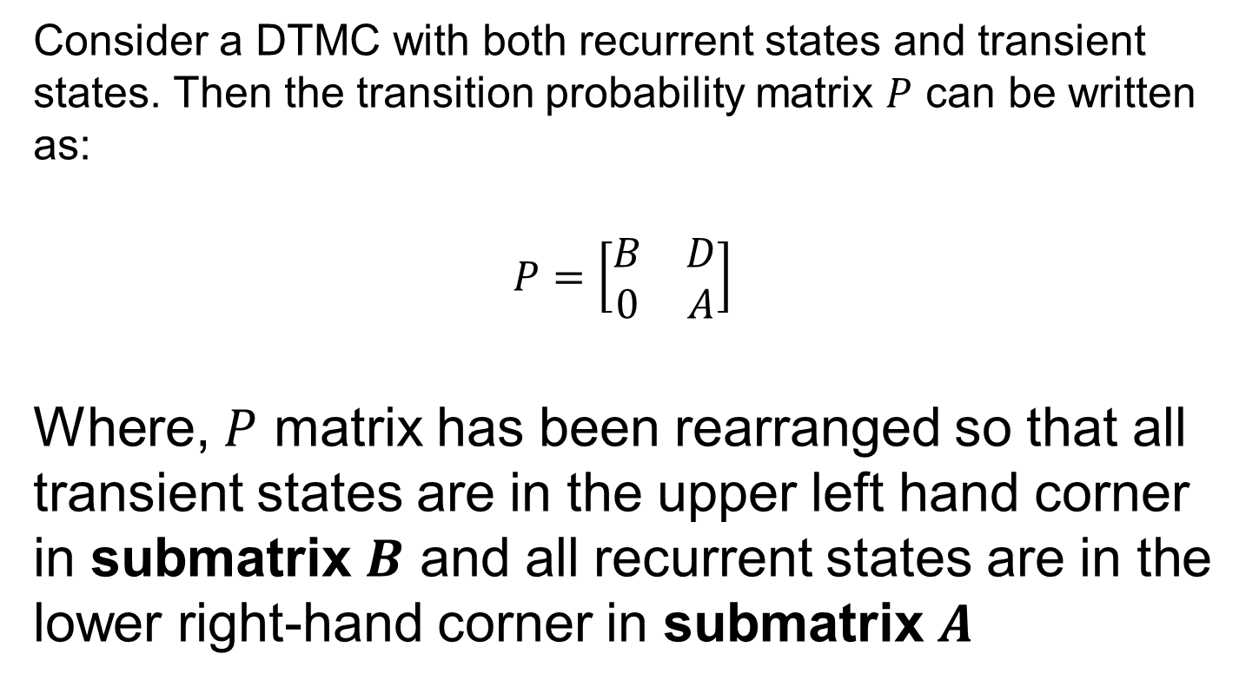
Multi Class DTMC
Consider a DTMC with both recurrent states and transient states. Then the transition probability matrix $P$ can be written as:
$$P=\left[\begin{matrix}B & D \\ 0 & A\end{matrix}\right]$$
Where, $P$ matrix has been rearranged so that all transient states are in the upper left hand corner in submatrix $B$ and all recurrent states are in the lower right-hand corner in submatrix $A$

Slide 5


Steady State Example Revisited
Consider a transition probability matrix:
Now lets list the equations to solve to find $π:$
$$π\left(I−P\right)=0$$
$$\left[π_{0},π_{1},π_{2}\right]\left[\begin{matrix}0.4 & −0.3 & −0.1 \\ −0.8 & 0.8 & 0 \\ −1 & 0 & 1\end{matrix}\right]=0$$
0.6 0.3 0.1
0.8 0.2 0
1 0 0
$$P=$$

Slide 6

Steady State Example Revisited
Now lets solve this to find $π:$
$$π\left(I−P\right)=0$$
$$\left[π_{0},π_{1},π_{2}\right]\left[\begin{matrix}0.4 & −0.3 & −0.1 \\ −0.8 & 0.8 & 0 \\ −1 & 0 & 1\end{matrix}\right]=0$$

Slide 7
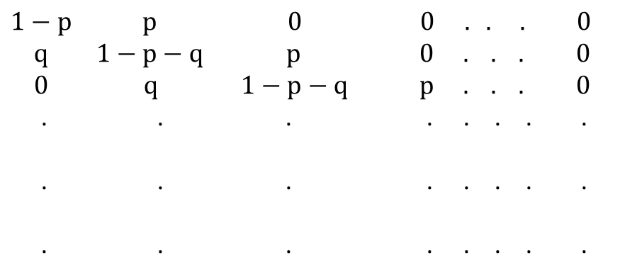
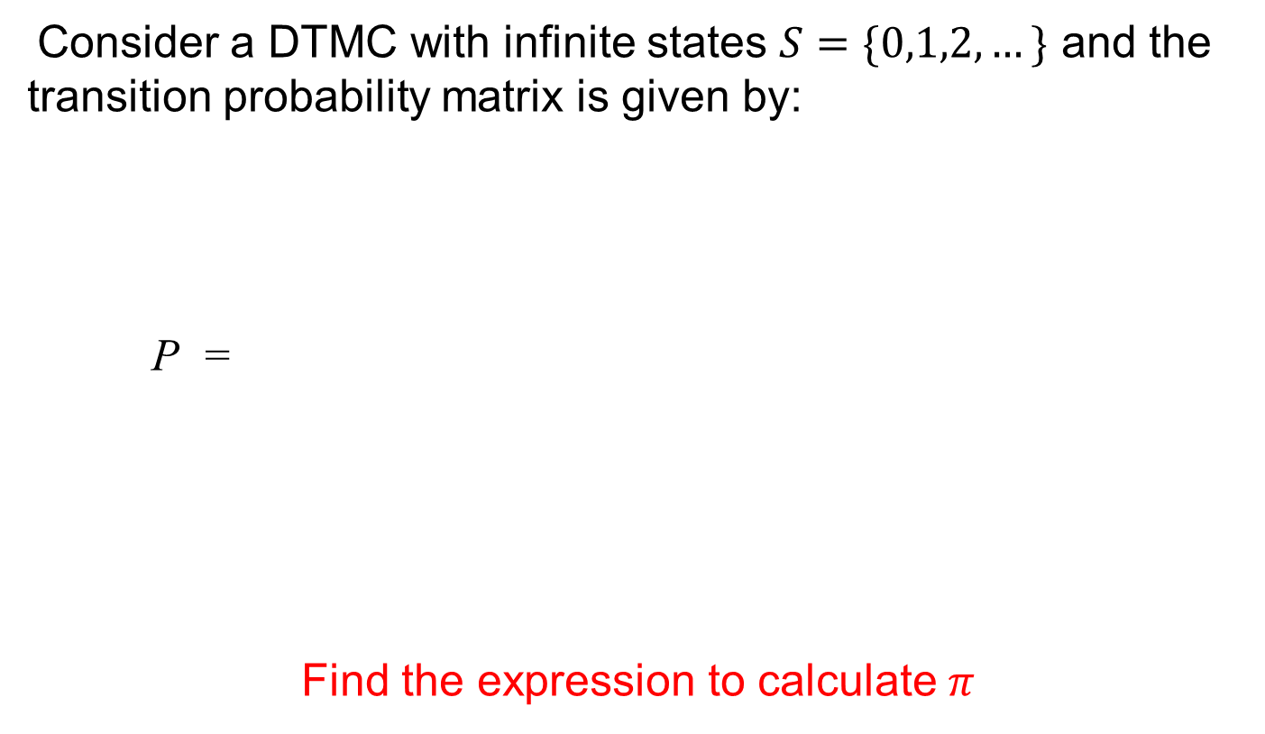
Infinite State Example
Consider a DTMC with infinite states $S=\{0,1,2,…\}$ and the transition probability matrix is given by:
P =
Find the expression to calculate $π$
$$1−p p 0 0 . . . 0$$
$$q 1−p−q p 0 . . . 0$$
$$0 q 1−p−q p . . . 0$$
. . . . . . . .
. . . . . . . .
. . . . . . . .

